Slide 1
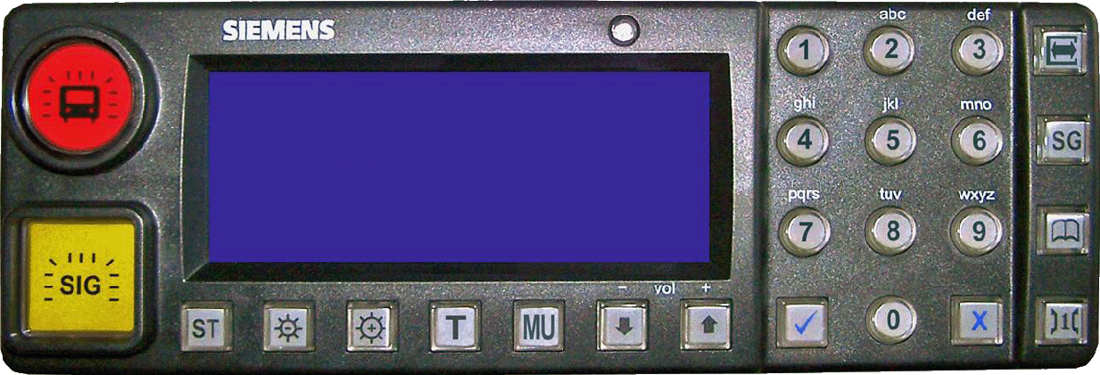

GSM-R Control
Status: Connected
Turn On
DefaultButton01
GSM-R GB 1Z99
Messages
Settings
Reset GSM-R
General
Broadcast
Emergency Group Call

Slide 2
Settings
Game Settings
Blocked Registrations
Phone Book List
Modify
General Broadcasts
Go Back

